Slide 1
Senior Design:
Braille Board
By Kairui Hu
Christopher Rios
Christopher Jaramillo

Slide 2
What’s the Problem?
Unemployment
Solution
Illiteracy
70% of Blind adults are unemployed
85% of Employed people with blindness can read and write with braille
Only 10% of Blind children are learning braille. Why is this?

Slide 3
what is Braille
Braille is a written language for The Blind, invented in 1824 by Louis Braille.
Grade 1 - Uncontracted - every Letter is spelled out
Grade 2 - contracted - more complex and has “shortcuts” where a word can represent an entire word

Slide 4
The downfall of Braille
Most Public Schools are not equipped to teach braille
85% of Blind Students go to public schools
Many teachers “failed to provide instructions in classes in a way that included students with [visual impairments].”
“50% of blind high school students drop out”
Current Braille Technology Is Expensive
BrailleNote Touch Plus 32 - $5,795
Orbit Reader 20 plus - $799
The Teacher Crisis
There is a shortage of qualified teachers to teach braille
Note *the National Federation of the Blind jernigan institute in a 2009 report named “Facing the Truth, Reversing the trend, Empowering the blind”
,Boise State University in the Journal of Statistics Education Volume 27, 2019 Issue 3, page 225-237, the article named “Teaching Visually Impaired College Students in Introductory Statistics”

Slide 5
Alternatives and Limitations
Audio
To people with complete blindness the only other path to literacy is Audio methods, such as Audio books, Screen Readers, etc.
One issue With Audio is efficiency, as reading, even in braille, is much faster.
Limitations

Slide 6
What is Our Vision?
Our Goal is to make a Braille Board and accompanying application for elementary, middle, and even high schools to better teach Braille to those who are blind as well as those who are interested in learning braille.

Slide 7
How the System Works/User Stories
Teacher
Has access to the application that is connected with the braille board.
Can write a text of 1000 characters to be translated from the application to the braille board
Student
Controls the Braille Board
Can “read” from the braille board
Able to iterate through each letter of the text via next and previous buttons
The teacher interacts with the UI
They determine what texts to translate
As well as when to cancel the previous text translation and when to input the new one.
The Student Interacts with the Hardware
They are only allowed to read the text that the teacher inputs in the UI

Slide 8
Functional Requirements
Input
Iteration
Movement
Output
Application must be able to take a user input that is under 1000 characters
if the user pressed the next/previous button the braille dots must move accordingly
After input submission the braille board dots must move according what the user had inputted
The Application must be able to show the result of the translation on the users UI

Slide 9
Response Time
Connection
Non-Functional Requirement
Economical
Repairable
Size
Light
The speed in which the translation occurs and the “dots” moving when the next/previous button is pressed must be under 1 second
There will be wifi to connect the Application with the Braille Board
Designed as to allow the hardware to have ease of repairability
Product must be a reasonable size to fit on a school desk, must be less than 20 inch by 12 inch by 6 inch
Product must be under 10 pounds
Must cost under $200

Slide 10
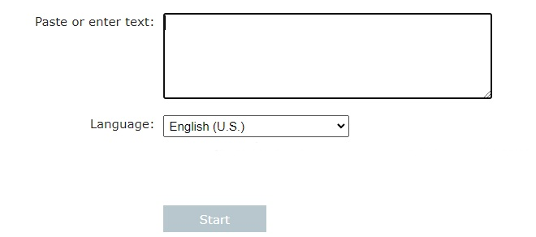
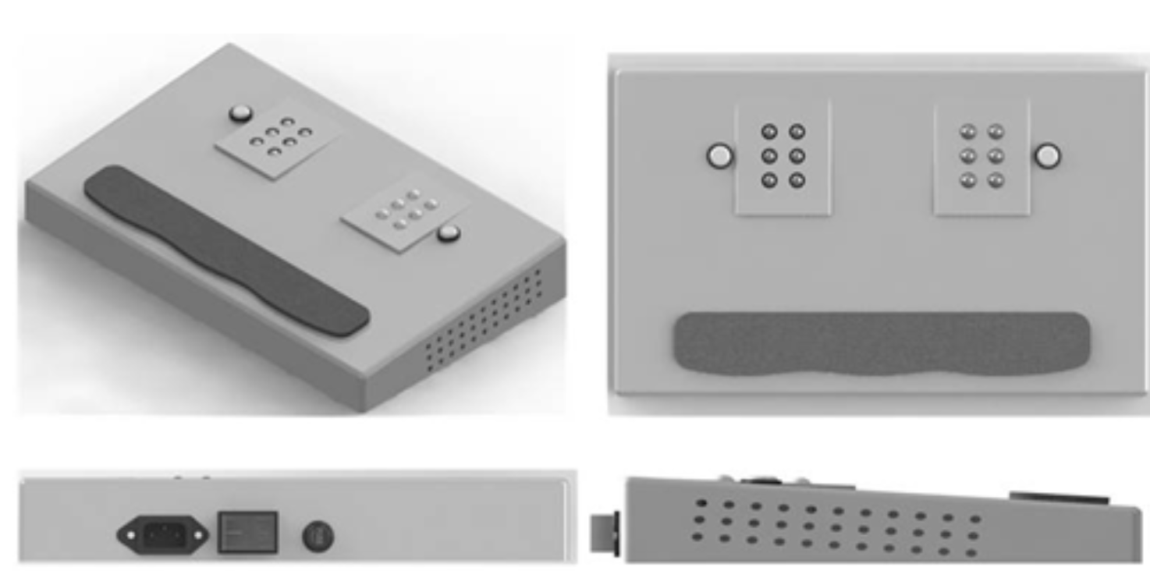
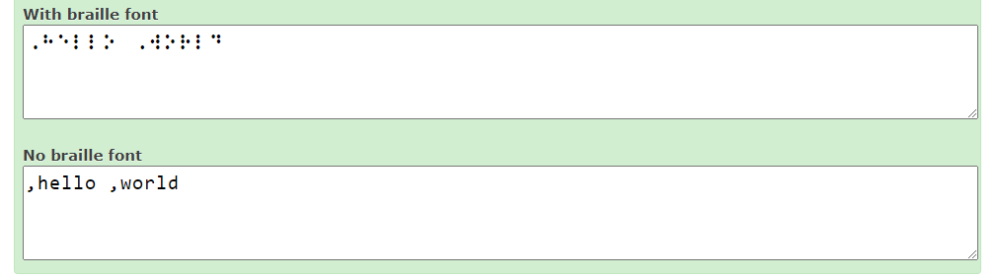
USER EXPERIENCE
UI Start
Braille Board
UI End

Slide 11
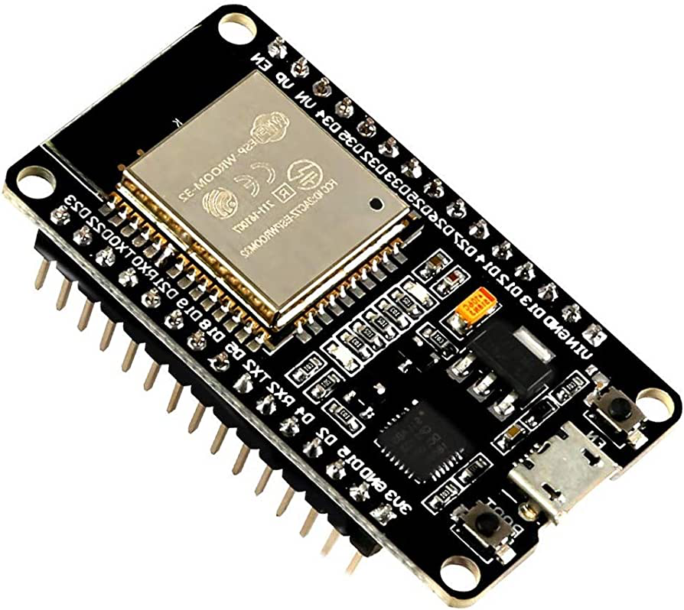
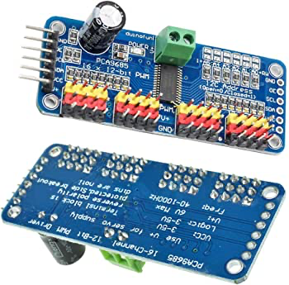
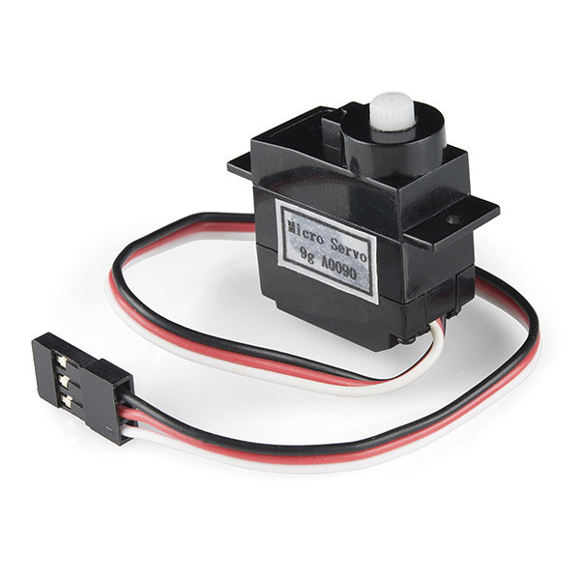
Main Equipment Used
ESP32
16 Channel 12 bit PWM Servo Motor Driver
Servo
The ESP32 is the brains of the hardware
It communicates between hardware and software
Built In WIFI & BlueTooth
Only needs 2 pins to control 16 servo individually
When connected with other drivers in series it can control 992 servos in total
180 Degree Movement

Slide 12
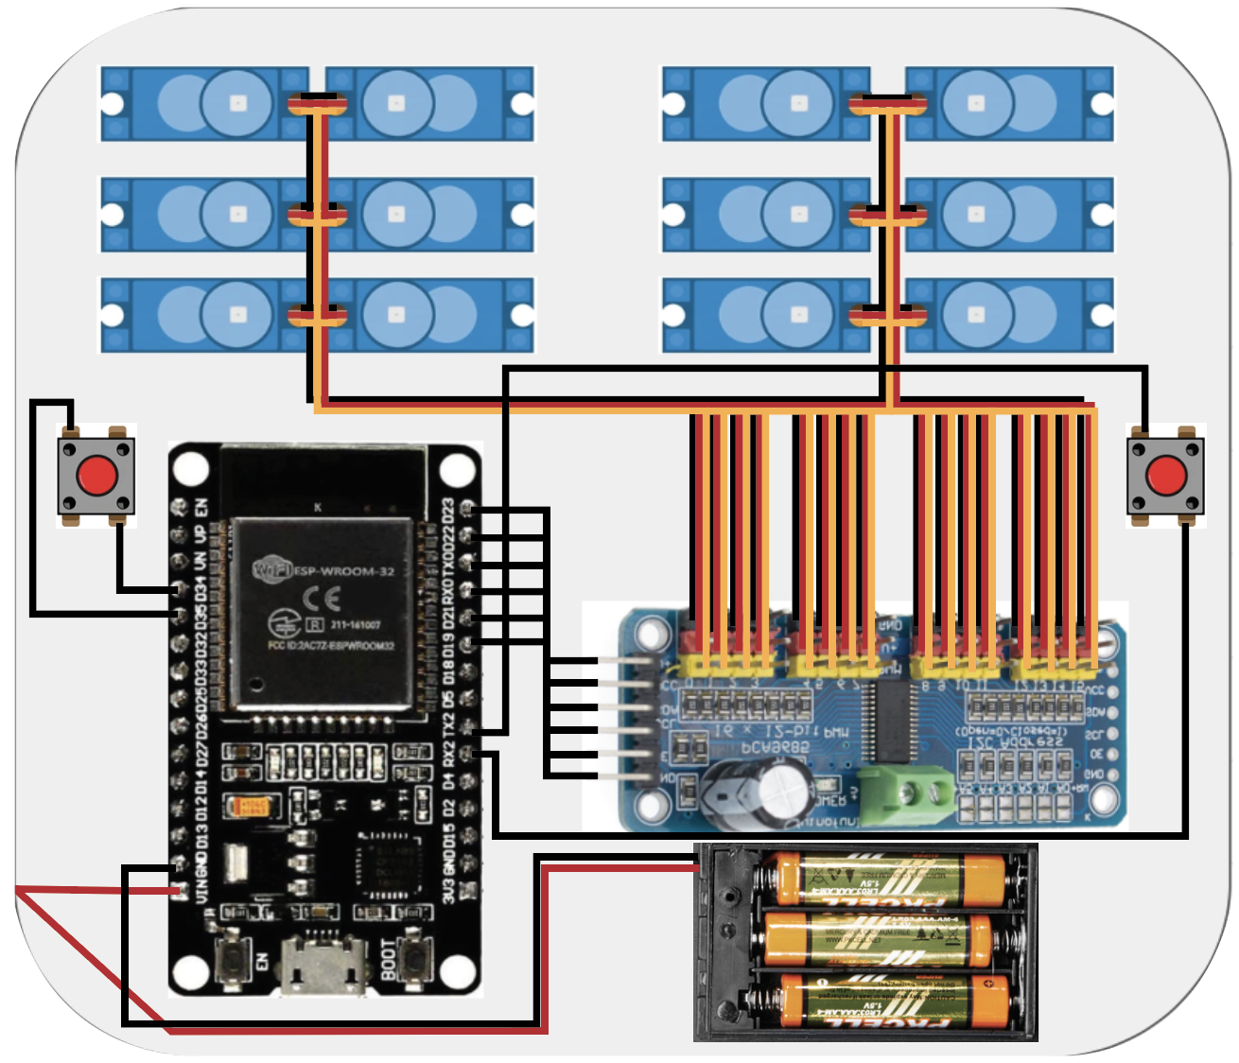
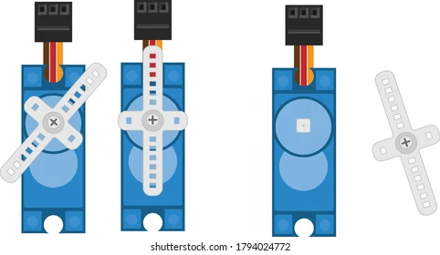
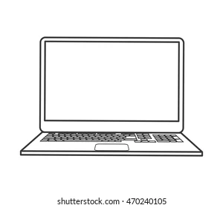
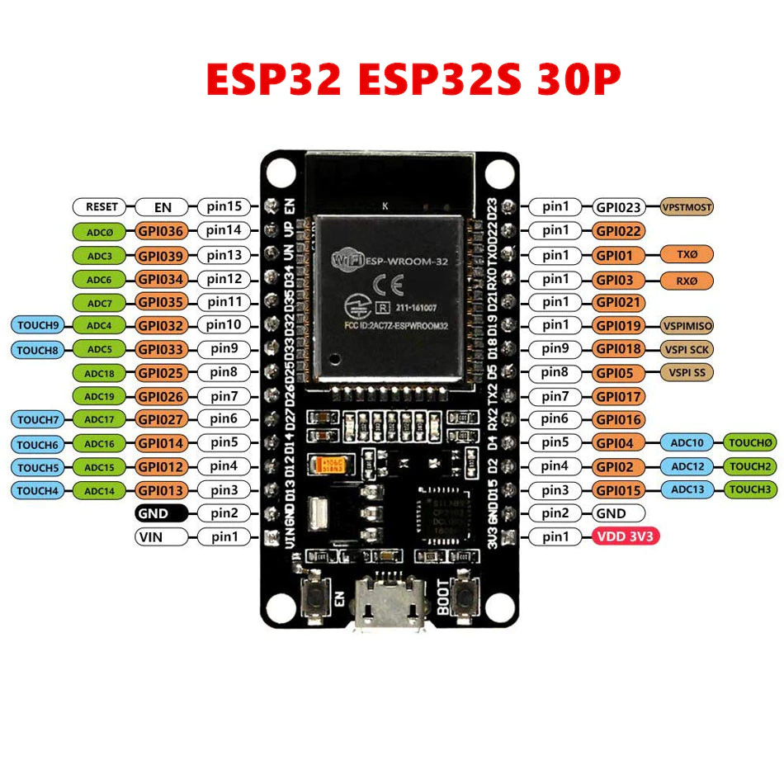
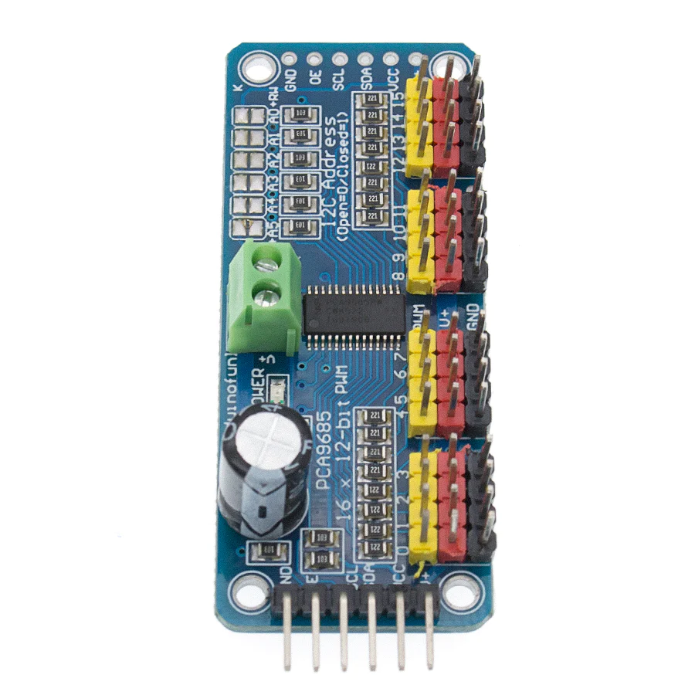
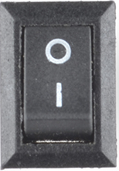
Schematic

Slide 13
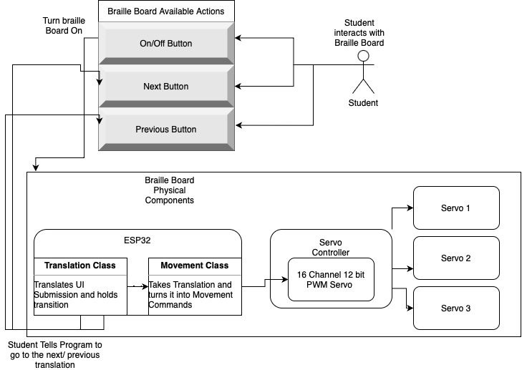
Hardware
System Design

Slide 14
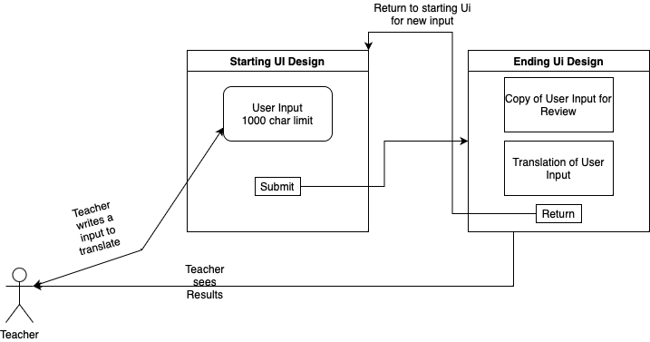
Software System Design

Slide 15
Project Plan: Sprints
00
01
03
02
Over the Summer
September
General Research on the Braille language, Research on possible dot movement methods, as well as testing the ESP32
Begin Programming the application and designing the hardware. UI demo separate
Combining Phase, Establish Connection between the software and hardware as well as 3d modeling the container. Hardware Demo
Testing Phase, Make sure everything works,and fix any bugs. Combined Demo
November - December
October

Slide 16
THANKS!
Any Questions?

